Slide 2
Open 07-Models.Rmd

Slide 3

The basics

Slide 4
Models
A low dimensional description of a higher dimensional data set.
modelr
CC BY-SA RStudio

Slide 5
Models
Algorithm
Data
Model Function
CC BY-SA RStudio

Slide 6
Models
What is the model function?
Algorithm
Data
Model Function
CC BY-SA RStudio

Slide 7
Models
What uncertainty is associated with it?
Algorithm
Data
Model Function
CC BY-SA RStudio

Slide 8
Models
How "good" is the model?
Algorithm
Data
Model Function
CC BY-SA RStudio

Slide 9
Models
What are the residuals?
Algorithm
Data
Model Function
CC BY-SA RStudio

Slide 10
Models
What are the predictions?
Algorithm
Data
Model Function
CC BY-SA RStudio

Slide 11
Algorithm
Algorithm
Algorithm
Algorithm
Algorithm
Algorithm
Algorithm
Algorithm
Algorithm
Algorithm
Algorithm
Algorithm
Algorithm
Algorithm
Algorithm
Algorithm
Algorithm
Algorithm
Algorithm
Algorithm
Algorithm
Algorithm
Algorithm
Algorithm
Algorithm
Algorithm
Algorithm
Algorithm
Algorithm
Algorithm
Algorithm
Algorithm
Algorithm
Algorithm
Algorithm
Algorithm
Algorithm
Algorithm
Algorithm
Algorithm
Algorithm
Algorithm
Algorithm
Algorithm
Algorithm
Algorithm
Algorithm
Algorithm
Algorithm
Algorithm
Algorithm
Algorithm
Algorithm
Algorithm
Algorithm
Algorithm
Algorithm
Algorithm
Algorithm
Algorithm
Algorithm
Algorithm
Algorithm
Algorithm
Algorithm
Algorithm
Algorithm
Algorithm
Algorithm
Algorithm
Algorithm
Algorithm
Algorithm
Algorithm
Algorithm
Algorithm
Algorithm
Algorithm
Algorithm
CC BY-SA RStudio

Slide 12
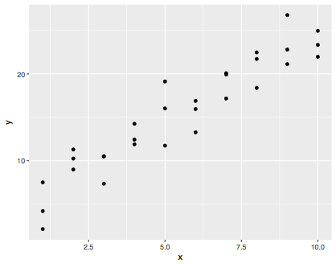
Example
modelr
CC BY-SA RStudio

Slide 13
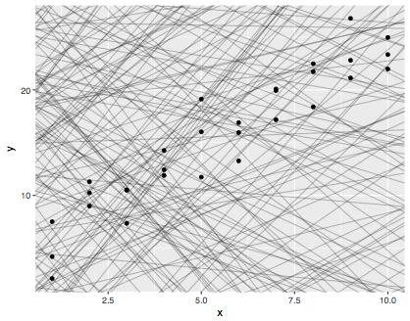
1. A family of functions
modelr
CC BY-SA RStudio

Slide 14
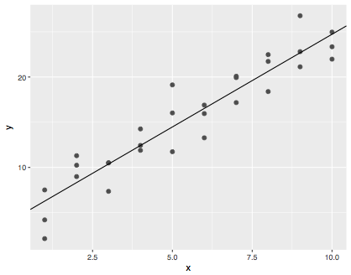
2. The best function of the family
modelr
CC BY-SA RStudio

Slide 15
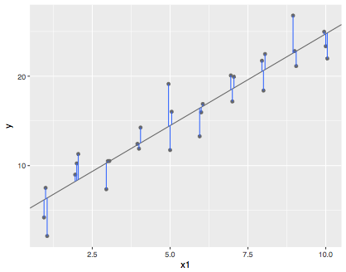
3. The residuals
modelr
CC BY-SA RStudio

Slide 16
(Popular) modeling functions in R
function | package | fits
lm() | stats | linear models
glm() | stats | generalized linear models
gam() | mgcv | generalized additive models
glmnet() | glmnet | penalized linear models
rlm() | MASS | robust linear models
rpart() | rpart | trees
randomForest() | randomForest | random forests
xgboost() | xgboost | gradient boosting machines
modelr
CC BY-SA RStudio

Slide 17
(Popular) modeling functions in R
function | package | fits
lm() | stats | linear models
glm() | stats | generalized linear models
gam() | mgcv | generalized additive models
glmnet() | glmnet | penalized linear models
rlm() | MASS | robust linear models
rpart() | rpart | trees
randomForest() | randomForest | random forests
xgboost() | xgboost | gradient boosting machines
modelr
CC BY-SA RStudio

Slide 18
modelr
Tidy functions that make it easier to work with models in R
# install.packages("tidyverse")
library(modelr)
wages <- heights %>% filter(income > 0)
modelr
modelr
CC BY-SA RStudio

Slide 19
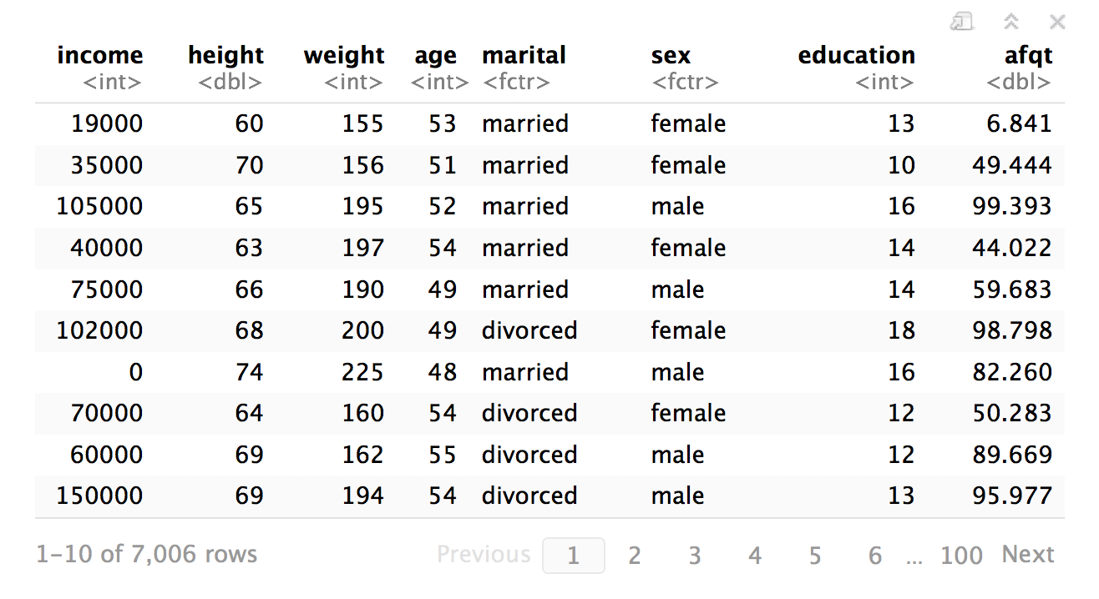
wages
modelr
CC BY-SA RStudio

Slide 20
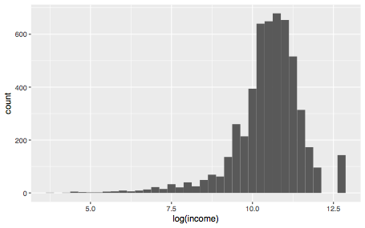
wages %>%
ggplot(aes(log(income))) + geom_histogram(binwidth = 0.25)
modelr
CC BY-SA RStudio

Slide 21
lm()

Slide 22
lm()
Fit a linear model to data
lm(log(income) ~ education, data = wages)
A formula that describes the model equation
The data set
modelr
CC BY-SA RStudio

Slide 23
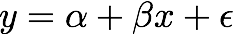


formulas
Formula only needs to include the response and predictors
y ~ x
y ~ x
modelr
CC BY-SA RStudio

Slide 24

Your Turn 1
Fit the model below and then examine the output. What does it look like?
mod_e <- lm(log(income) ~ education, data = wages)

Slide 25
mod_e <- lm(log(income) ~ education, data = wages)
mod_e
## Call:
## lm(formula = log(income) ~ education, data = wages)
##
## Coefficients:
## (Intercept) education
## 8.5577 0.1418
class(mod_e)
## "lm"
Not pipe friendly to have data as second argument :(
Output is not tidy, or even a data frame
CC BY-SA RStudio

Slide 26
.
Use "." to pipe input to somewhere other than the first argument
mod_e <- wages %>%
lm(log(income) ~ education, data = .)
wages will be passed to here
modelr
CC BY-SA RStudio

Slide 27
broom

Slide 28

broom
Turns model output into data frames
# install.packages("tidyverse")
library(broom)
CC BY-SA RStudio

Slide 29
broom
Broom includes three functions which work for most types of models (and can be extended to more):
tidy() - returns model coefficients, stats
glance() - returns model diagnostics
augment() - returns predictions, residuals, and other raw values
CC BY-SA RStudio

Slide 30
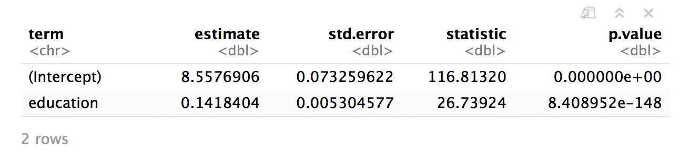
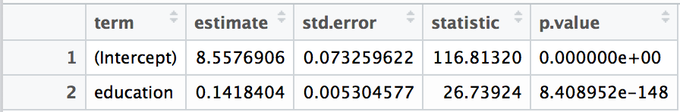
tidy()
Returns useful model output as a data frame
mod_e %>% tidy()
CC BY-SA RStudio

Slide 31
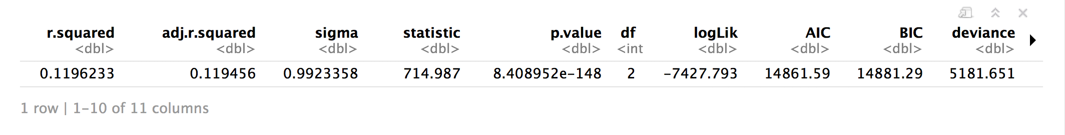
glance
Returns common model diagnostics as a data frame
mod_e %>% glance()
CC BY-SA RStudio

Slide 32
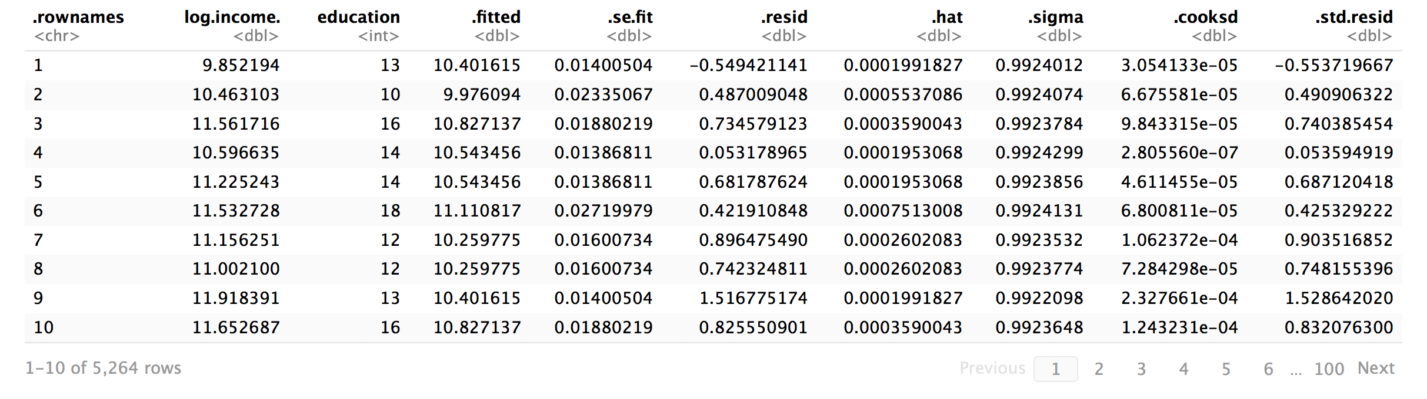
augment()
Returns data frame of model output related to original data points
mod_e %>% augment()
CC BY-SA RStudio

Slide 33
augment()
Returns data frame of model output related to original data points
mod_e %>% augment(data = wages)
Adds the original wages data set to the output
CC BY-SA RStudio

Slide 34

Your Turn 2
Use a pipe to model log(income) against height. Then use broom and dplyr functions to extract:
The coefficient estimates and their related statistics
The adj.r.squared and p.value for the overall model

Slide 35
mod_h <- wages %>% lm(log(income) ~ height, data = .)
mod_h %>%
tidy()
## term estimate std.error statistic p.value
## 1 (Intercept) 6.98342583 0.237484827 29.40578 4.129821e-176
## 2 height 0.05197888 0.003521666 14.75974 2.436945e-48
mod_h %>%
glance() %>%
select(adj.r.squared, p.value)
## adj.r.squared p.value
## 1 0.03955779 2.436945e-48
CC BY-SA RStudio

Slide 36
mod_h %>%
tidy() %>% filter(p.value < 0.05)
## term estimate std.error statistic p.value
## 1 (Intercept) 6.98342583 0.237484827 29.40578 4.129821e-176
## 2 height 0.05197888 0.003521666 14.75974 2.436945e-48
mod_e %>%
tidy() %>% filter(p.value < 0.05)
## term estimate std.error statistic p.value
## 1 (Intercept) 8.5576906 0.073259622 116.81320 0.000000e+00
## 2 education 0.1418404 0.005304577 26.73924 8.408952e-148
so which determines income?
CC BY-SA RStudio

Slide 37
multivariate
regression

Slide 38
To fit multiple predictors,
add multiple variables to the formula:
log(income) ~ education + height
CC BY-SA RStudio

Slide 39

Your Turn 3
Model log(income) against education and height. Do the coefficients change?

Slide 40
mod_eh <- wages %>%
lm(log(income) ~ education + height, data = .)
mod_eh %>%
tidy()
## term estimate std.error statistic p.value
## 1 (Intercept) 5.34837618 0.231320415 23.12107 1.002503e-112
## 2 education 0.13871285 0.005205245 26.64867 7.120134e-147
## 3 height 0.04830864 0.003309870 14.59533 2.504935e-47
CC BY-SA RStudio

Slide 41
Your Turn 4
Model log(income) against education and height and sex. Can you interpret the coefficients?

Slide 42
mod_ehs <- wages %>%
lm(log(income) ~ education + height + sex, data = .)
mod_ehs %>%
tidy()
## term estimate std.error statistic p.value
## 1 (Intercept) 8.250422260 0.334703051 24.649976 4.681336e-127
## 2 education 0.147983063 0.005196676 28.476486 5.164290e-166
## 3 height 0.006726614 0.004792698 1.403513 1.605229e-01
## 4 sexfemale -0.461747002 0.038941592 -11.857425 5.022841e-32
What does this mean?
Where is sexmale?
CC BY-SA RStudio

Slide 43
## term estimate std.error statistic p.value
## 1 (Intercept) 8.250422260 0.334703051 24.649976 4.681336e-127
## 2 education 0.147983063 0.005196676 28.476486 5.164290e-166
## 3 height 0.006726614 0.004792698 1.403513 1.605229e-01
## 4 sexfemale -0.461747002 0.038941592 -11.857425 5.022841e-32
For factors, R treats the first level as the baseline level, e.g. the mean log(income) for a male is:
log(income) = 8.25 + 0.15 * education + 0 * height
Each additional level gets a coefficient that acts as an adjustment between the baseline level and the additional level, e.g. the mean income for a female is:
log(income) = 8.25 + 0.15 * education + 0 * height - 0.46
CC BY-SA RStudio

Slide 44
## term estimate std.error statistic p.value
## 1 (Intercept) 8.250422260 0.334703051 24.649976 4.681336e-127
## 2 education 0.147983063 0.005196676 28.476486 5.164290e-166
## 3 height 0.006726614 0.004792698 1.403513 1.605229e-01
## 4 sexfemale -0.461747002 0.038941592 -11.857425 5.022841e-32
For factors, R treats the first level as the baseline level, e.g. the mean log(income) for a male is:
log(income) = 8.25 + 0.15 * education + 0 * height
Each additional level gets a coefficient that acts as an adjustment between the baseline level and the additional level, e.g. the mean income for a female is:
log(income) = 8.25 + 0.15 * education + 0 * height - 0.46
CC BY-SA RStudio

Slide 45
## term estimate std.error statistic p.value
## 1 (Intercept) 8.250422260 0.334703051 24.649976 4.681336e-127
## 2 education 0.147983063 0.005196676 28.476486 5.164290e-166
## 3 height 0.006726614 0.004792698 1.403513 1.605229e-01
## 4 sexfemale -0.461747002 0.038941592 -11.857425 5.022841e-32
But what does all of this look like?
CC BY-SA RStudio

Slide 46
model
visualization

Slide 47
Your Turn 5
Use a broom function and ggplot2 to make a line graph of height vs .fitted for our heights model, mod_h.
Bonus: Overlay the plot on the original data points.

Slide 48
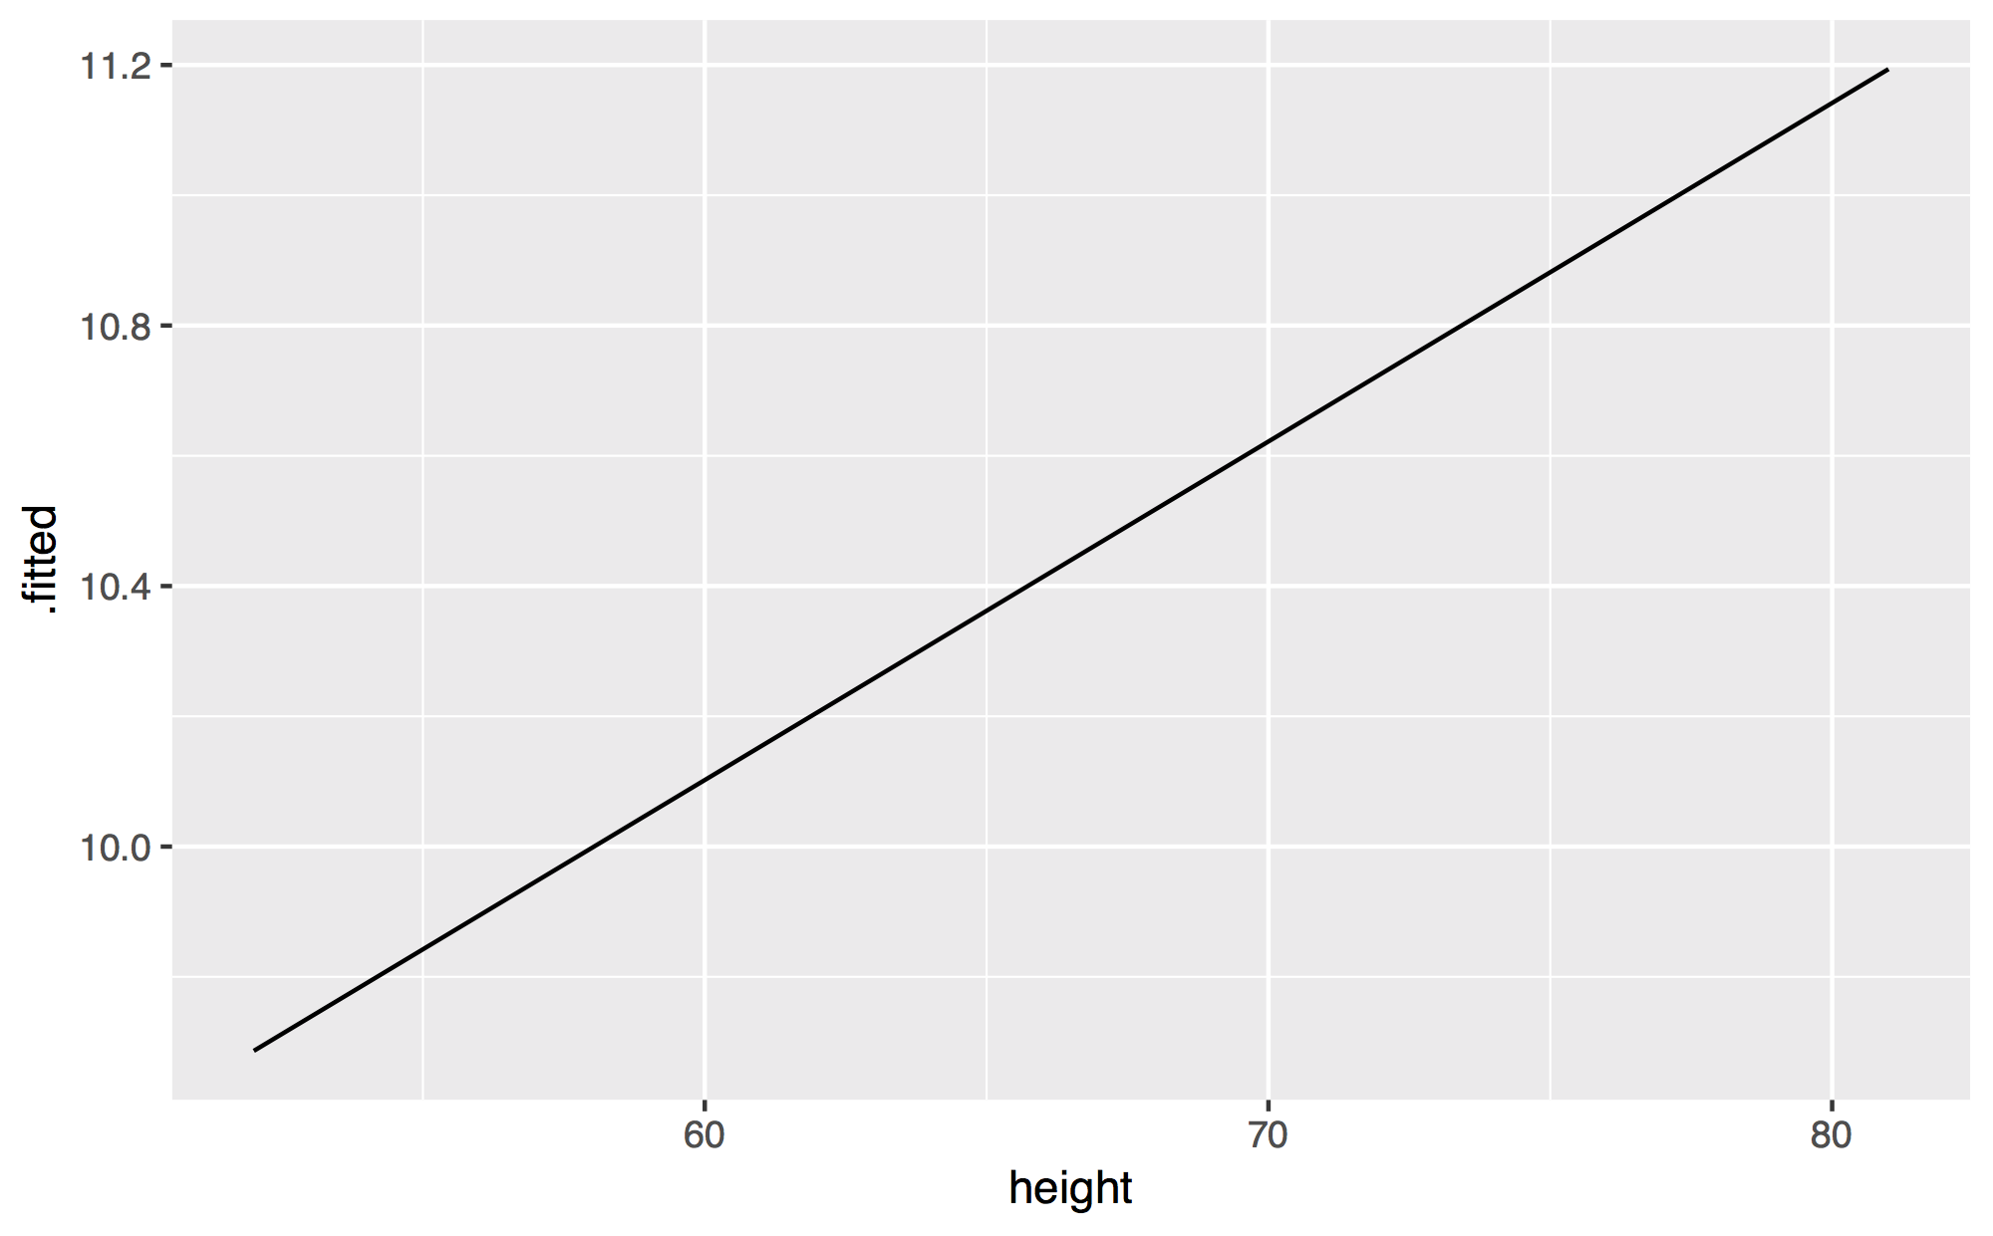
mod_h %>%
augment(data = wages) %>%
ggplot(mapping = aes(x = height, y = .fitted)) +
geom_line()
CC BY-SA RStudio

Slide 49
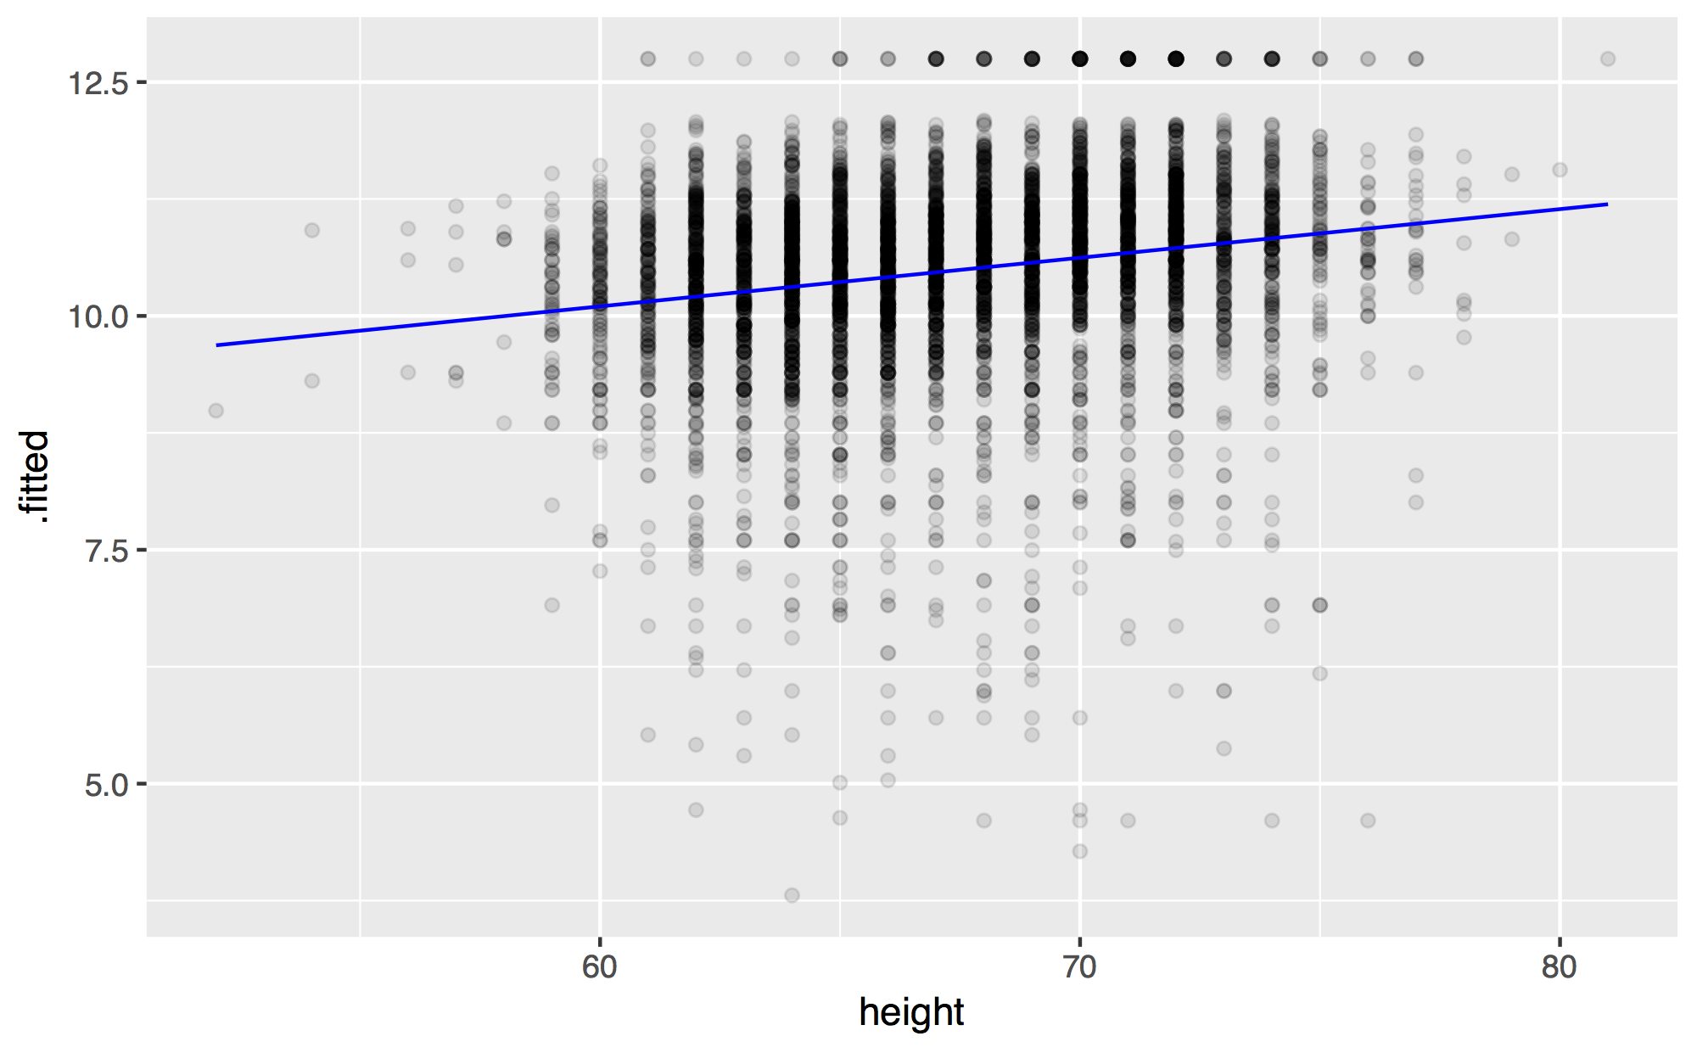
mod_h %>%
augment(data = wages) %>%
ggplot(mapping = aes(x = height, y = .fitted)) +
geom_point(mapping = aes(y = log(income)), alpha = 0.1) +
geom_line(color = "blue")
CC BY-SA RStudio

Slide 50
Your Turn 6
Repeat the process to make a line graph of height vs .fitted colored by sex for model mod_ehs. Are the results interpretable?
Add + facet_wrap(~education) to the end of your code. What happens?

Slide 51
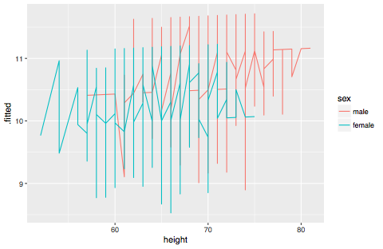
mod_ehs %>%
augment(data = wages) %>%
ggplot(mapping = aes(x = height, y = .fitted, color = sex)) +
geom_line()
CC BY-SA RStudio

Slide 52
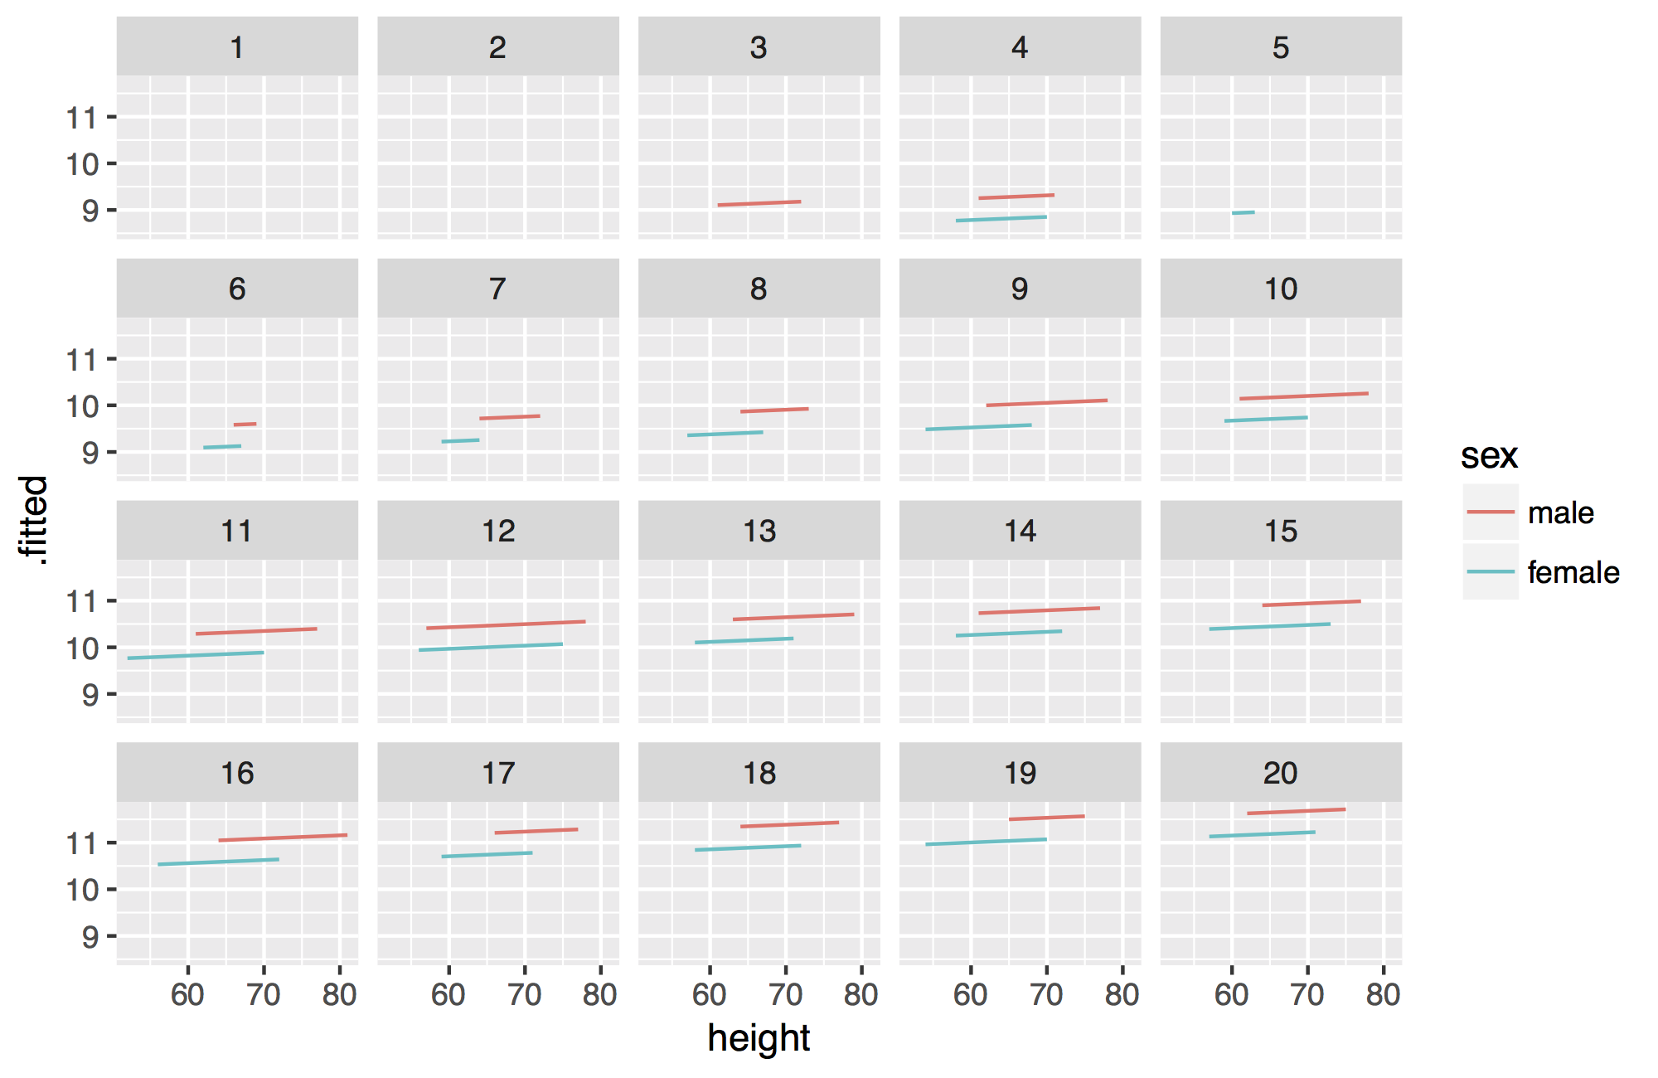
mod_ehs %>%
augment(data = wages) %>%
ggplot(mapping = aes(x = height, y = .fitted, color = sex)) +
geom_line() +
facet_wrap(~ education)
CC BY-SA RStudio

Slide 53
CC BY-SA RStudio

Slide 54
facet_wrap()
Divides plot into subplots based on a grouping variable. "Wraps" subplots into rectangular collection.
+ facet_wrap(~ var)
Always a ~
Name of the grouping variable. No quotes.
modelr
CC BY-SA RStudio

Slide 55
How can we compare the predictions of different models?
CC BY-SA RStudio

Slide 56
visualizing multiple models

Slide 57
modelr
Tidy functions that make it easier to work with models in R
# install.packages("tidyverse")
library(modelr)
modelr
modelr
CC BY-SA RStudio

Slide 58
add_predictions()
Uses the values in a data frame to generate a prediction for each case. Overlaps with augment()*
add_predictions(data, model)
Uses this model
To add predictions to these cases
modelr
CC BY-SA RStudio

Slide 59
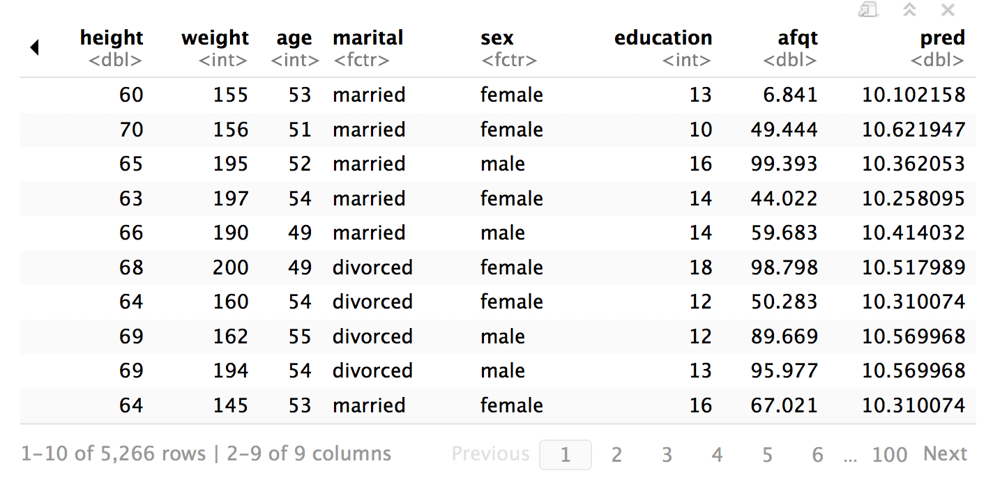
wages %>% add_predictions(mod_h)
modelr
CC BY-SA RStudio

Slide 60
spread_predictions()
Adds predictions for multiple models, each in their own column.
spread_predictions(data, …)
Adds predictions from each of these models
To the cases in this data frame
modelr
CC BY-SA RStudio

Slide 61
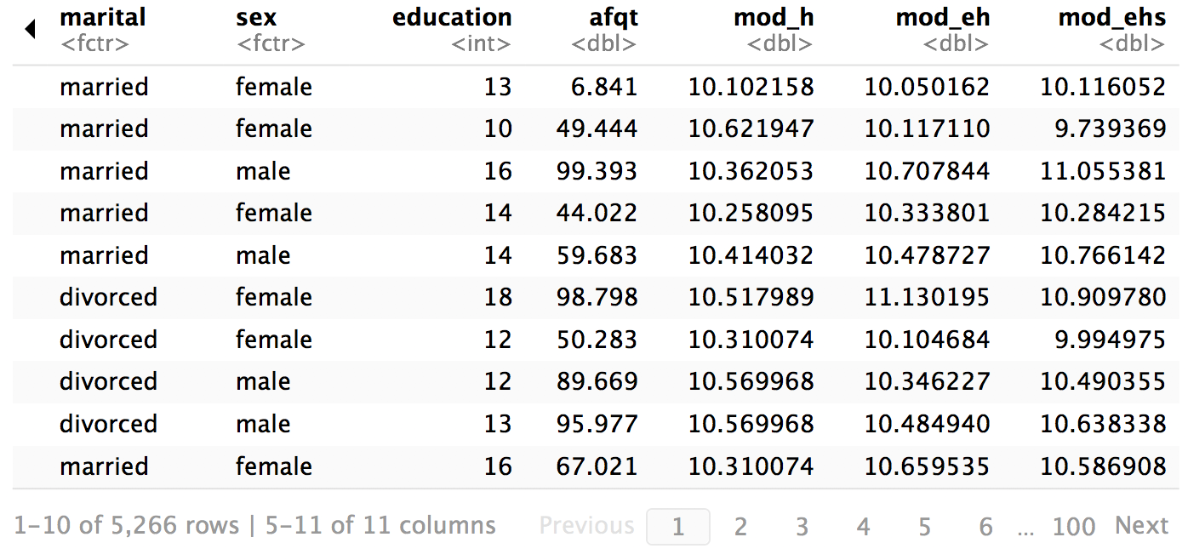
wages %>%
spread_predictions(mod_h, mod_eh, mod_ehs)
modelr
CC BY-SA RStudio

Slide 62
gather_predictions()
Adds predictions for multiple models as a pair of key:value columns (model:pred)
gather_predictions(data, …)
Adds predictions from each of these models
To the cases in this data frame (duplicating rows as necessary)
modelr
CC BY-SA RStudio

Slide 63
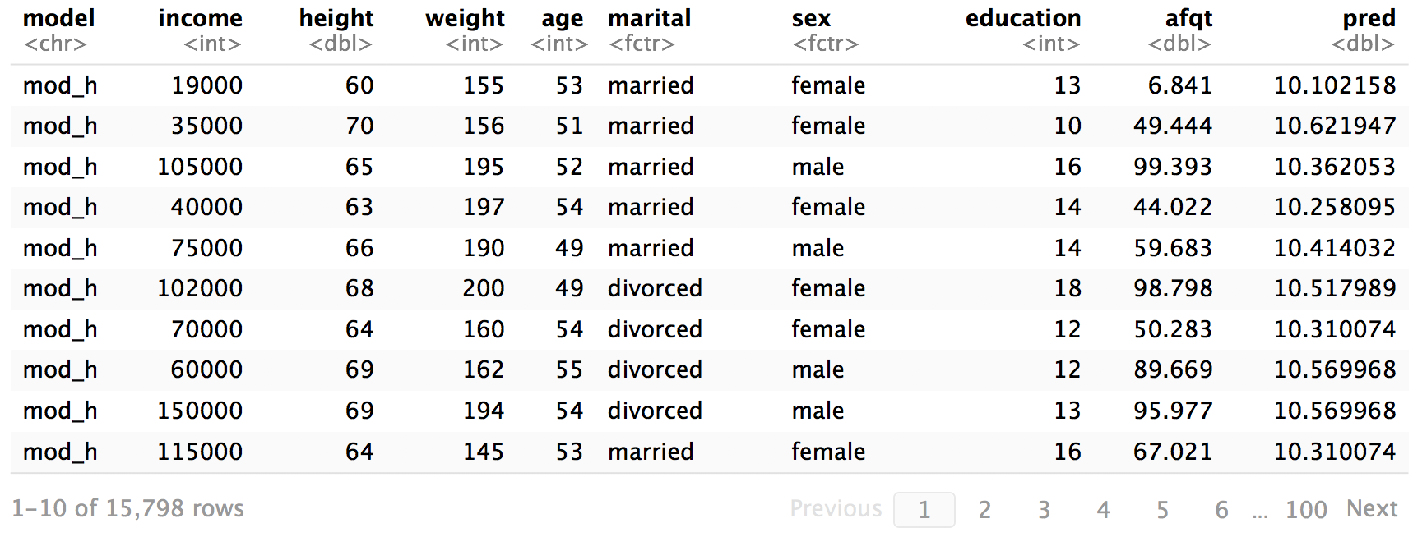
wages %>%
gather_predictions(mod_h, mod_eh, mod_ehs)
modelr
CC BY-SA RStudio

Slide 64

Your Turn 7
Use one of spread_predictions() or gather_predictions() to make a line graph of height vs pred colored by model for each of mod_h, mod_eh, and mod_ehs. Are the results interpretable?
Add + facet_grid(sex ~ education) to the end of your code. What happens?

Slide 65
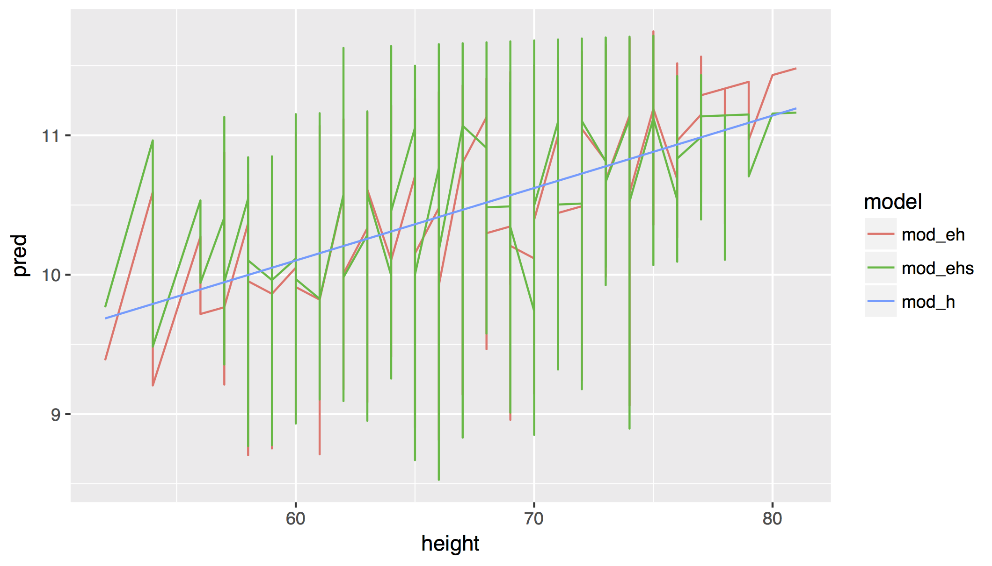
wages %>%
gather_predictions(mod_h, mod_eh, mod_ehs) %>%
ggplot(mapping = aes(x = height, y = pred, color = model)) +
geom_line()
modelr
CC BY-SA RStudio

Slide 66
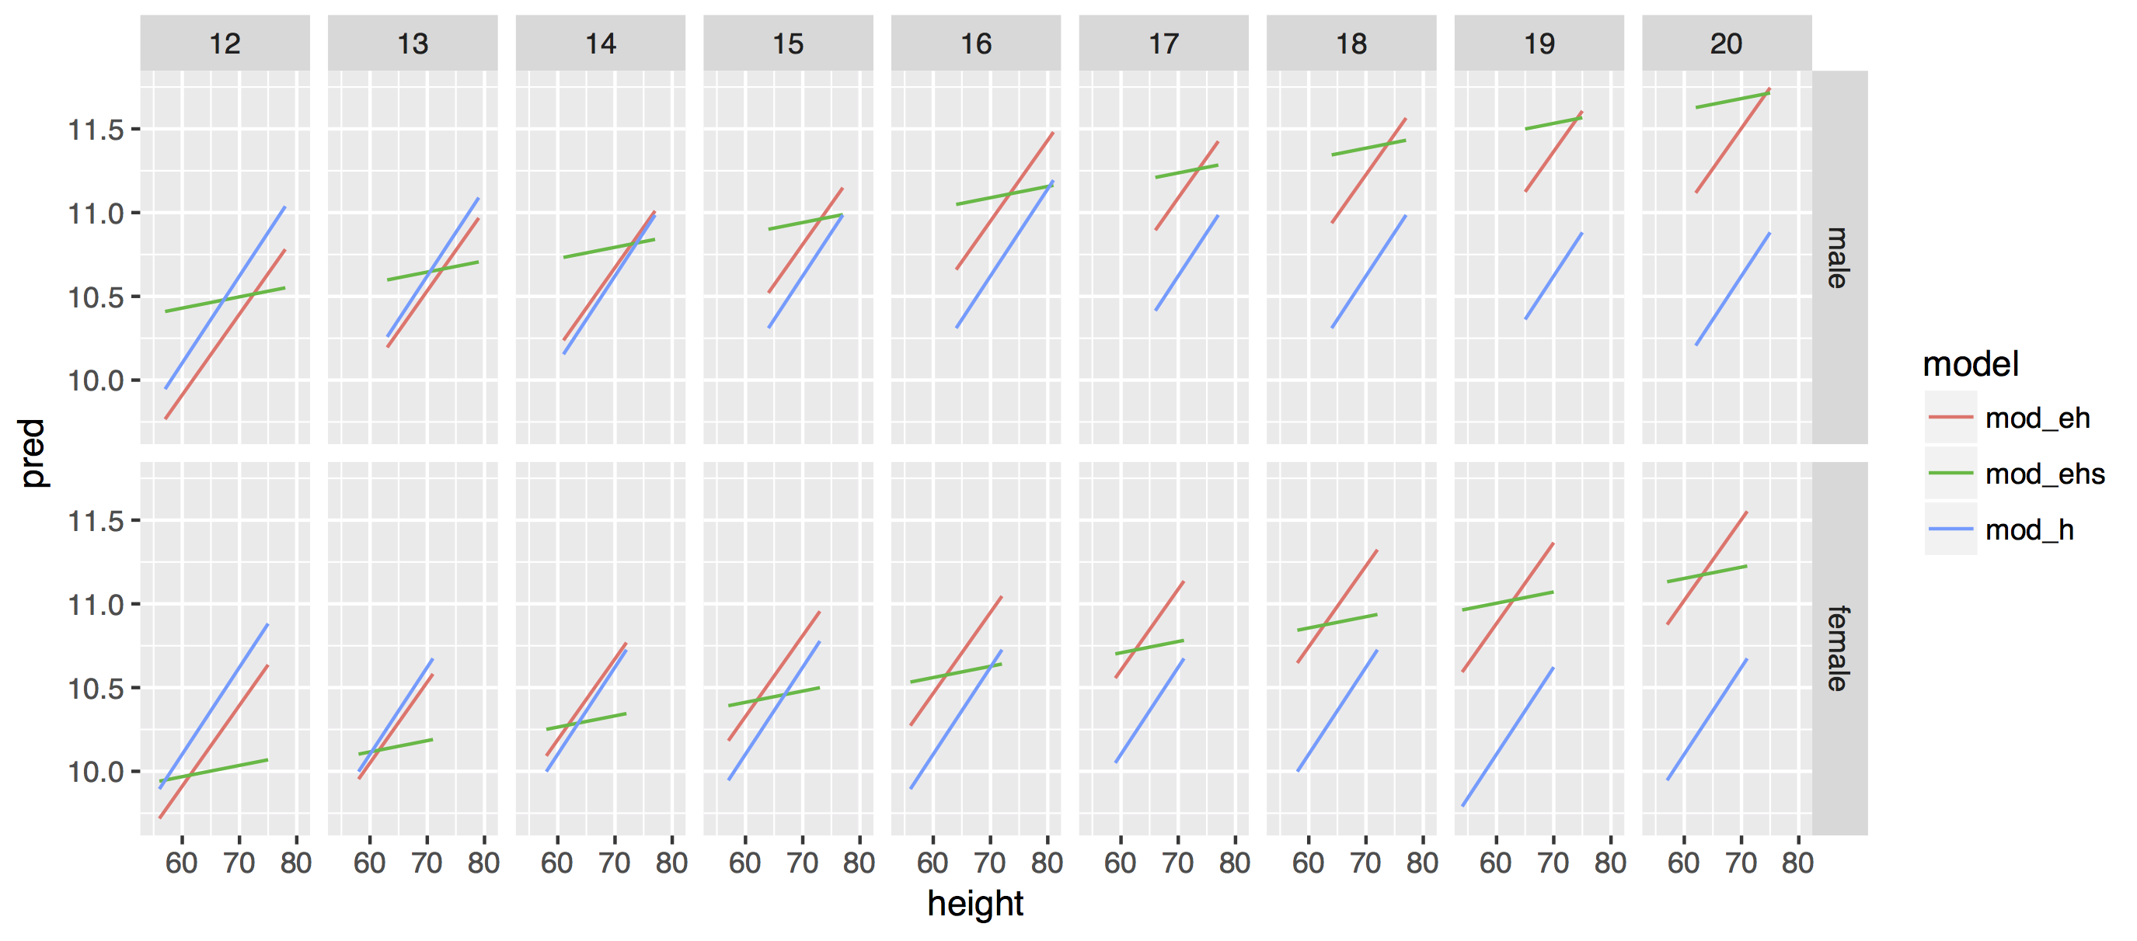
wages %>%
gather_predictions(mod_h, mod_eh, mod_ehs) %>%
ggplot(mapping = aes(x = height, y = pred, color = model)) +
geom_line() +
facet_grid(sex ~ education)
modelr
CC BY-SA RStudio

Slide 67
modelr
CC BY-SA RStudio

Slide 68
Residuals
Modelr provides the equivalent functions for residuals
add_predictions()
spread_predictions()
gather_predictions()
add_residuals()
spread_residuals()
gather_residuals()
modelr
CC BY-SA RStudio

Slide 69
wages %>%
add_residuals(mod_e)
Residuals
Modelr provides the equivalent functions for residuals
add_predictions()
spread_predictions()
gather_predictions()
add_residuals()
spread_residuals()
gather_residuals()
modelr
CC BY-SA RStudio

Slide 70
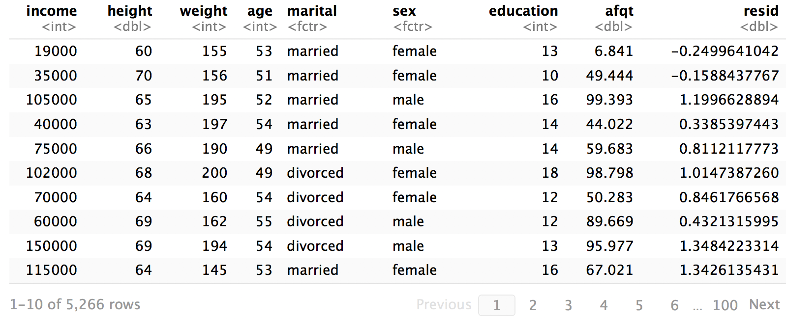
wages %>%
add_residuals(mod_h)
CC BY-SA RStudio

Slide 71
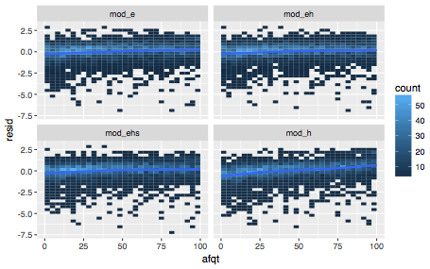

Your Turn
Use a modelr residual function with geom_bin2d, geom_smooth, and facetting to make this plot that compares patterns in the residuals.

Slide 72
wages %>%
gather_residuals(mod_e, mod_h, mod_eh, mod_ehs) %>%
ggplot(aes(afqt, resid)) +
geom_bin2d() +
geom_smooth() +
facet_wrap(~model)
modelr
CC BY-SA RStudio

Slide 73
modelr
CC BY-SA RStudio

Slide 74
Recap
Use glance(), tidy(), and augment() to return model values in a data frame.
Use add_predictions() or gather_predictions() or spread_predictions() to visualize predictions.
modelr
Use add_residuals() or gather_residuals() or spread_residuals() to visualize residuals.
modelr
CC BY-SA RStudio

